Slide 1
Catalpa nana
Lindenmayer system

Slide 2
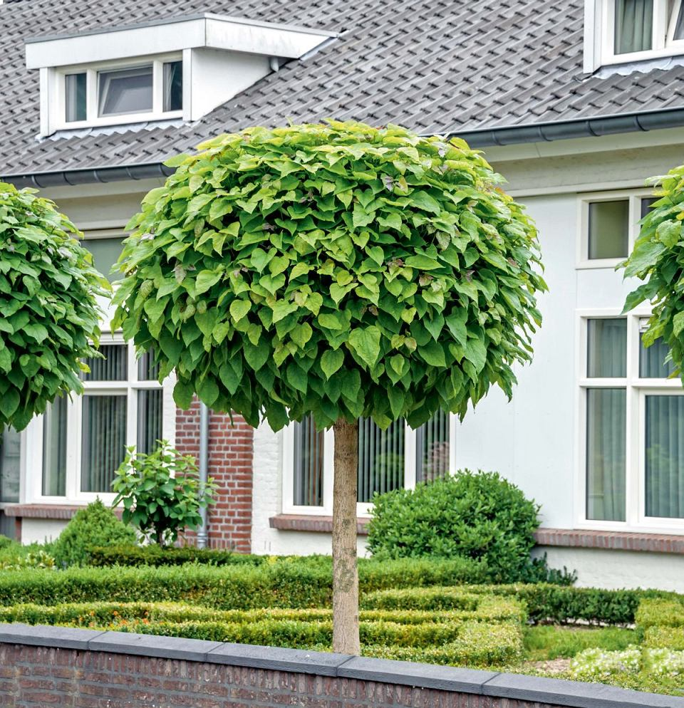
Fully grown tree

Slide 4
Leaf

